Slide 1

Recommend(verb): giới thiệu /ˌrekəˈmend/

Slide 2

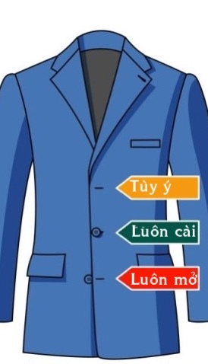
Formally dressed(noun): ăn mặc trang trọng
/ˈfɔːr.məl drest /

